Slide 1
Minority Language Use in the US
Charlie Ryan

Slide 2
Research Question
Has the linguistic landscape of the United States transformed between 1980 and 2010? If so, in what way?
Identify the languages have declined or risen in use
Identify those which have remained stable
Tentative hypothesis: changes in the linguistic landscape correlate directly with immigration patterns

Slide 3
Data
US Census Bureau provided data on minority languages spoken at home from 1980, 1990, 2000, and 2010
Data is available in tabular format online, converted into CSV

Slide 4
Methodology
Install packages - tidyverse, treemap
Create condensed language table
Create ranked language table
Generate charts

Slide 5
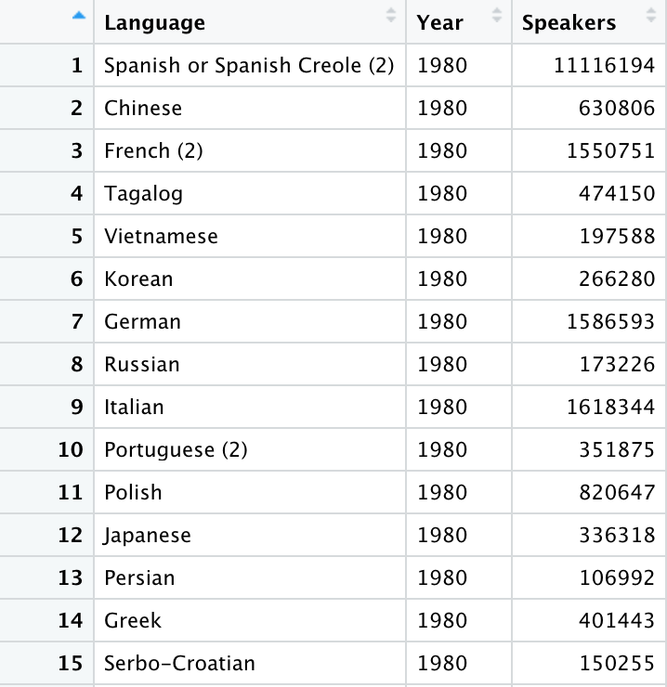
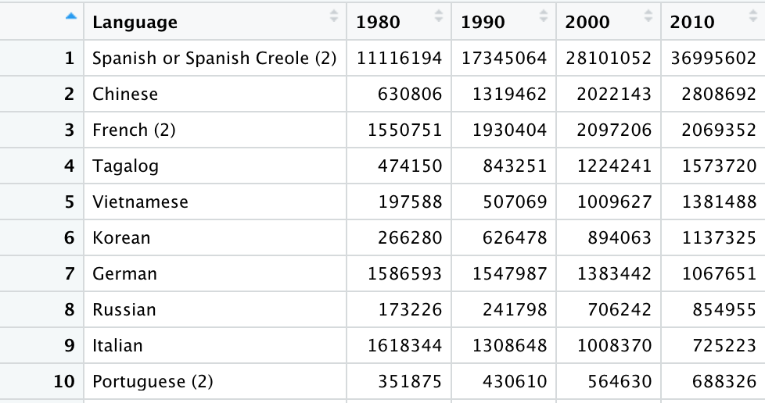
Condensing the data

Slide 6
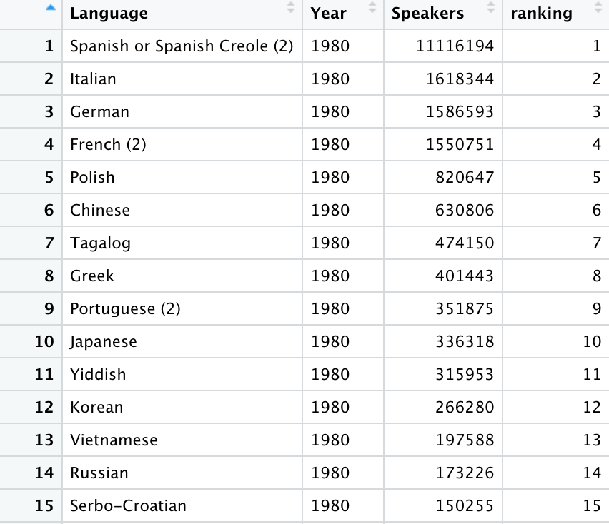
Ranked table

Slide 7
Charts
Expressing change in raw terms
Expressing change in relative, ranked terms
Snapshots of each decade - expressing composition

Slide 8
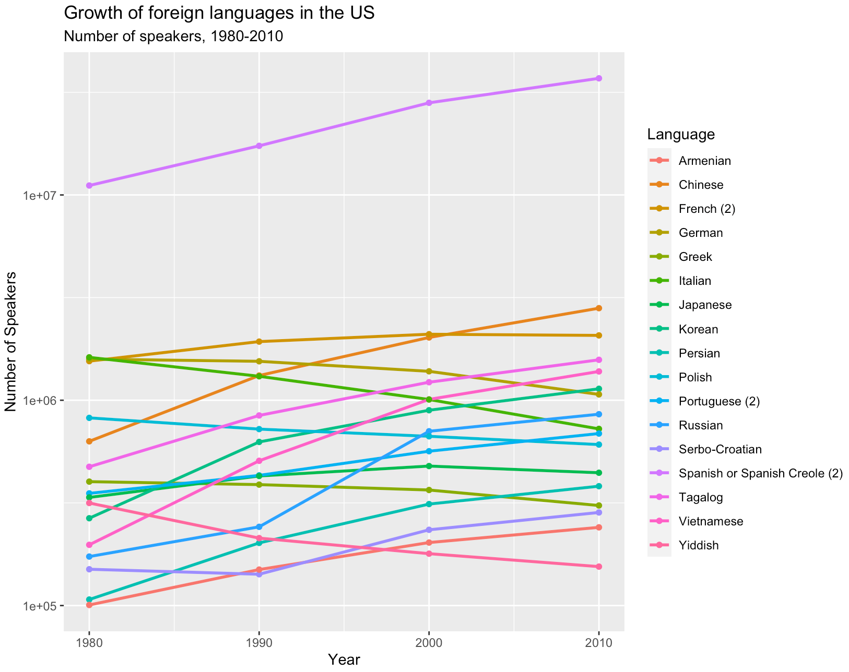

Slide 9
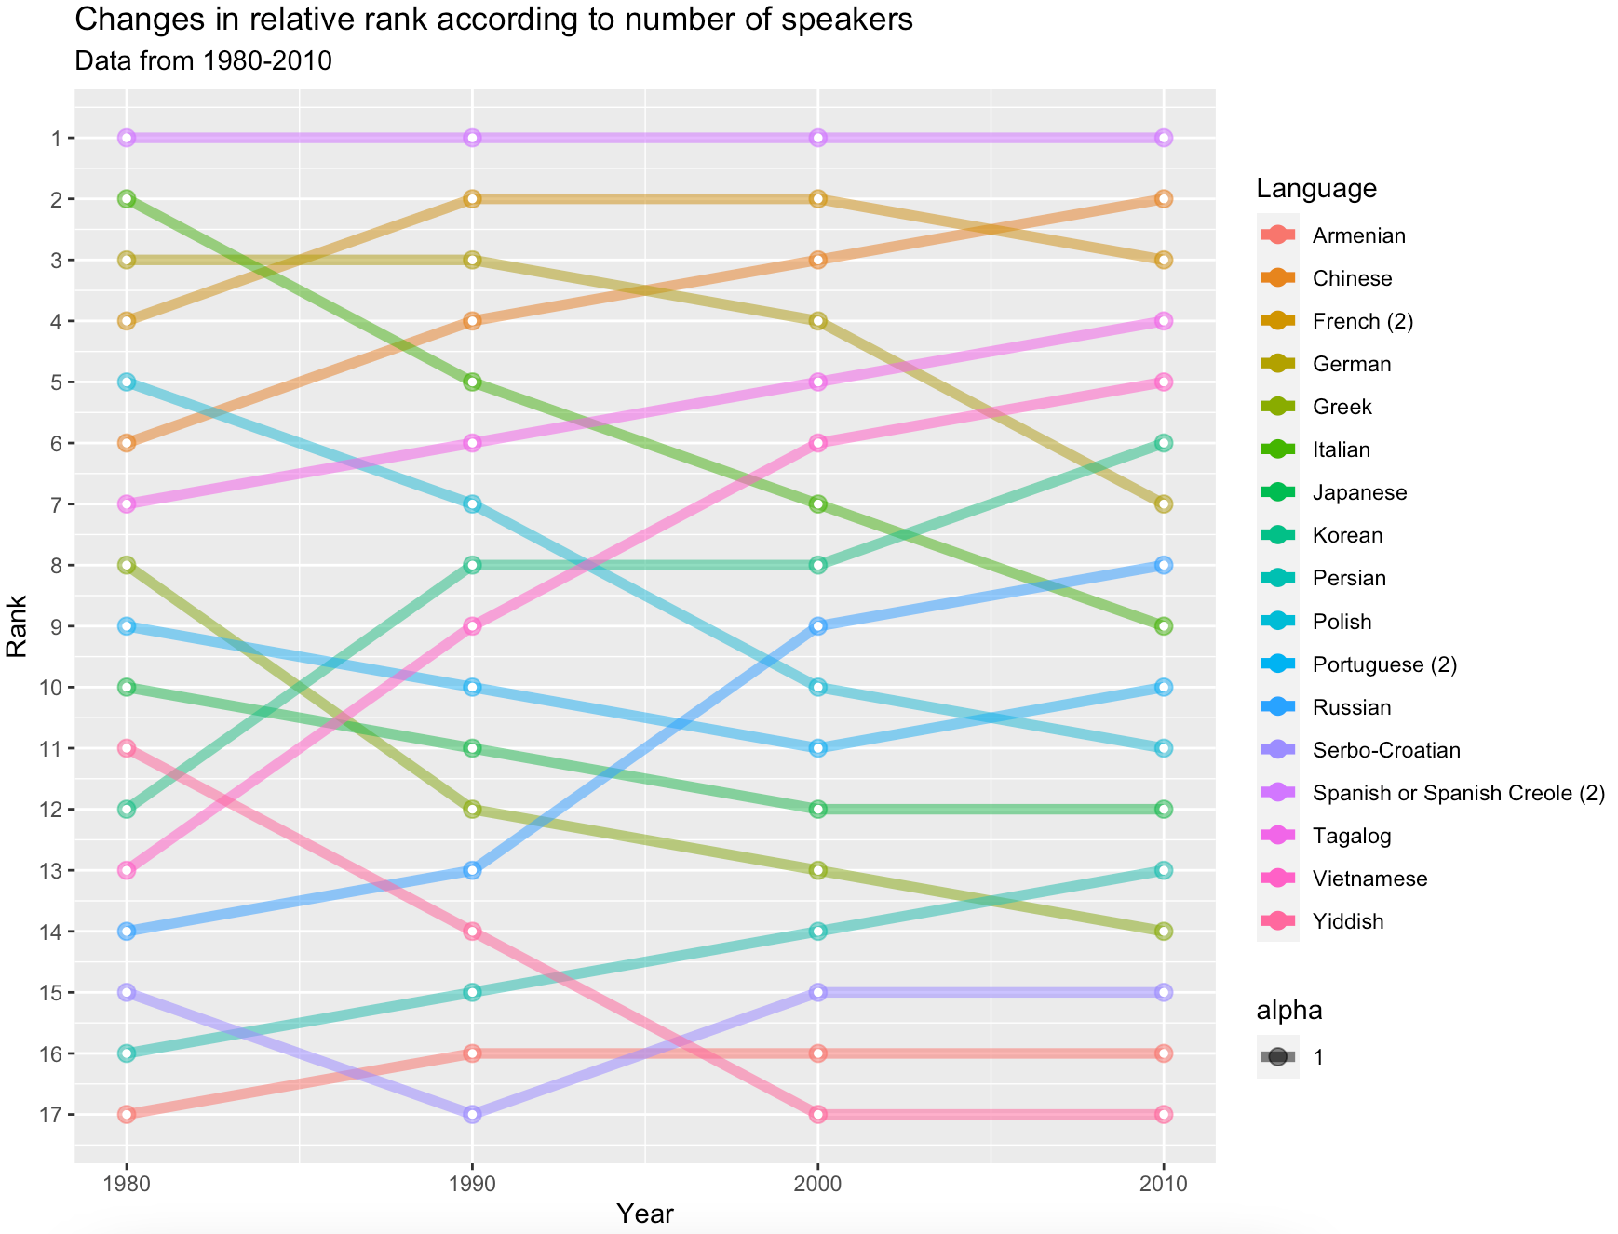

Slide 10
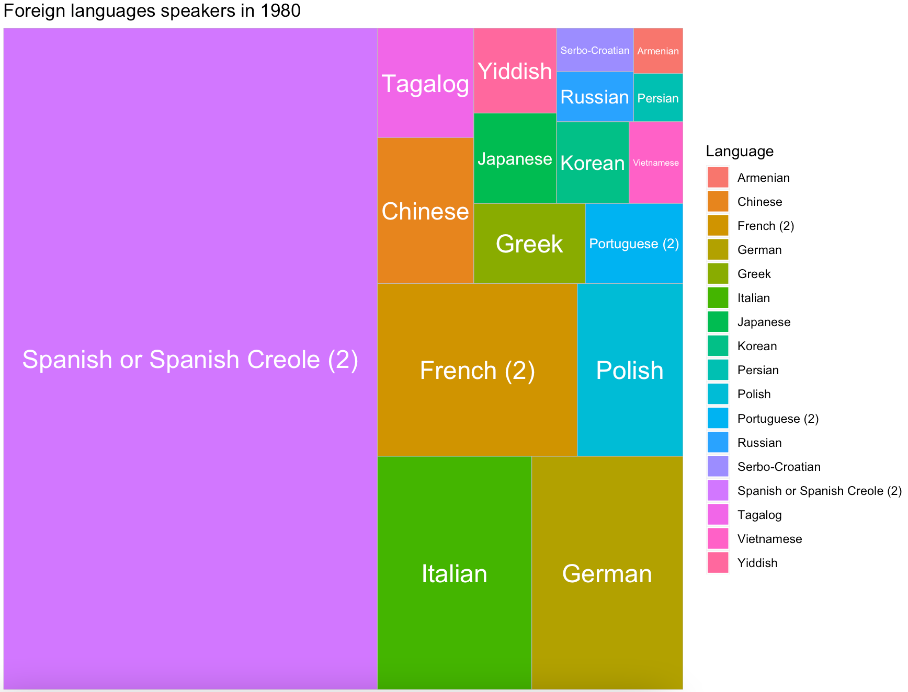

Slide 11
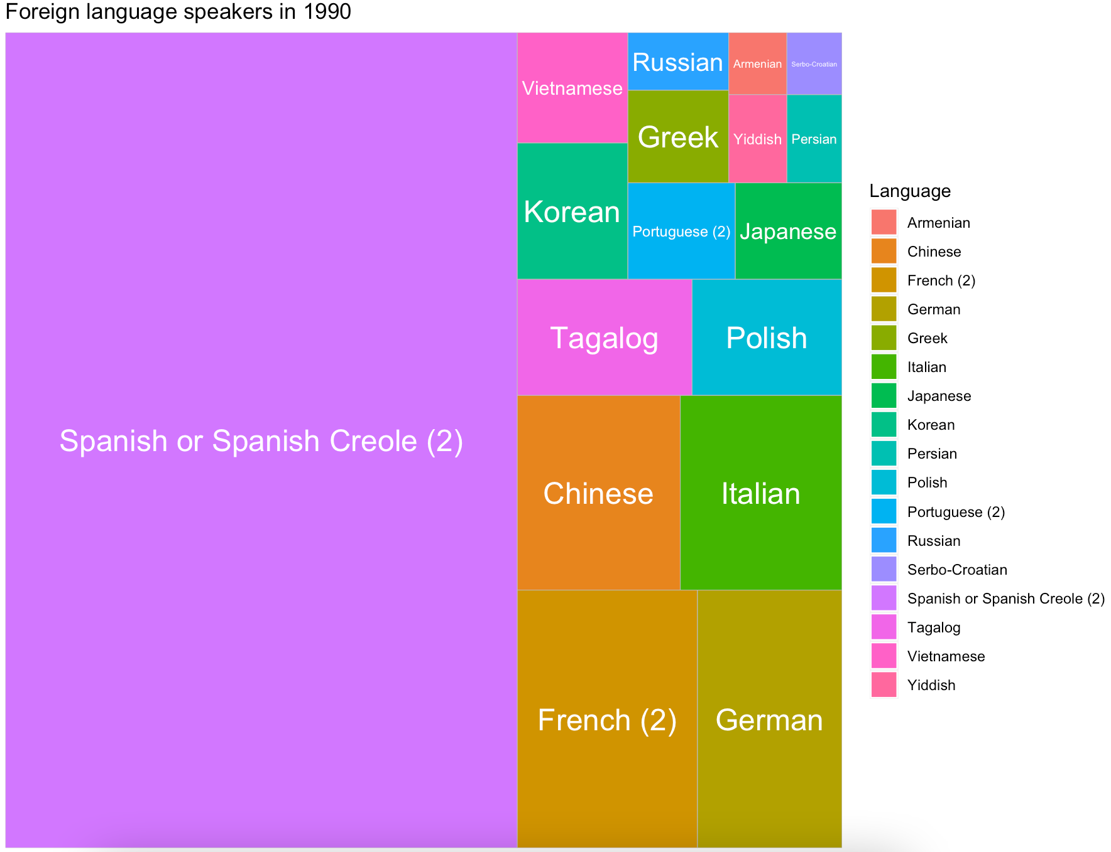

Slide 12
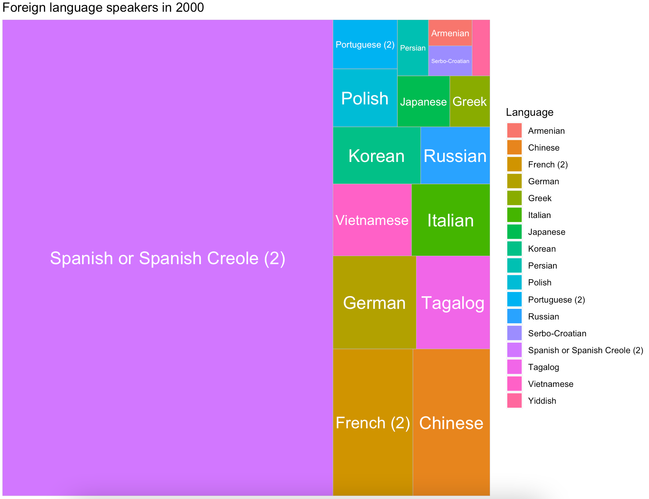

Slide 13
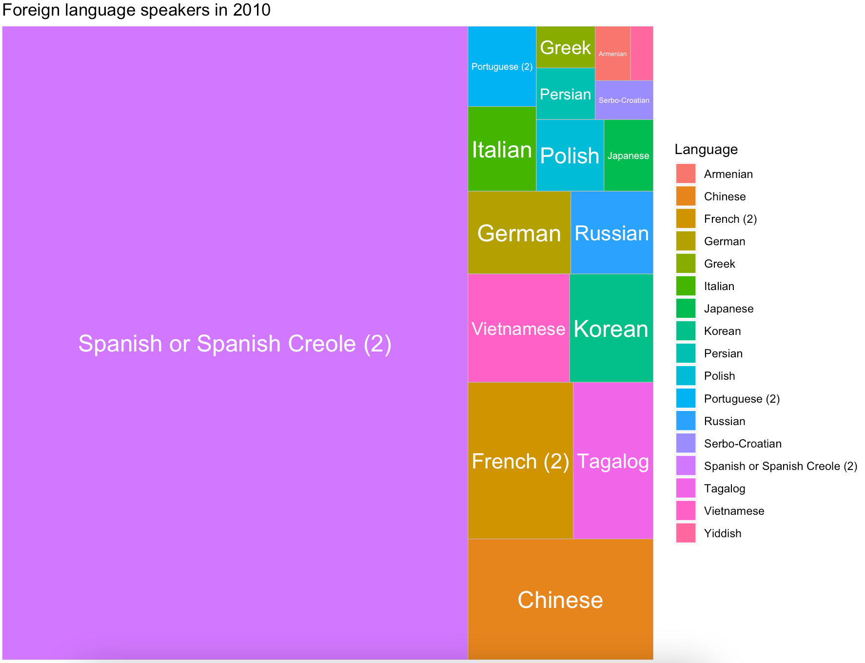

Slide 14
Findings
Linguistic landscape has changed! Sort of…
Stability of Spanish & French
Decline in several european languages: Italian, German, Polish, Greek
Rise in use of Asian languages: Chinese, Tagalog, Vietnamese, Korean
General correlation with immigration, but does not explain everything

